Slide 1

POSCAT Seminar 4 : Adv. Data Structure
yougatup @ POSCAT

Slide 2
Topic
Topic today
Heap ( Just for your knowledge )
D-ary heap
Binomial heap
Fibonacci heap
Indexed Tree
Binary Indexed Tree
Fenwick Tree
Implementation of Indexed Tree

Slide 3
Heap
You already know what it is
Definition ?
Amazingly, there is faster data structures
Fibonacci heap 은 이론적으로 Time complexity 가장 적음
But, 구현해보면 느림 → 실제로 쓰지는 않습니다
d-ary heap, Binomial heap, Fibonacci heap
Operations
find_min, delete_min, insert, delete, decrease_key

Slide 4




$d$-ary heap
It has child at most $d$
Extended version of binary heap
How it works ?
We use it for Prim algorithm
$$⋅⋅⋅$$
find_min ?
insert ?
delete ?
decrease_key ?
delete_min ?
at most $d$

Slide 5
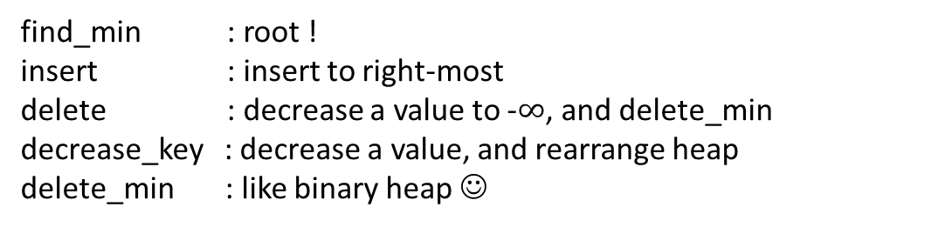
$d$-ary heap
It has child at most $d$
Extended version of binary heap
How it works ?
We use it for Prim algorithm
$$⋅⋅⋅$$
at most $d$
find_min : root !
insert : insert to right-most
delete : decrease a value to -$∞$, and delete_min
decrease_key : decrease a value, and rearrange heap
delete_min : like binary heap ☺

Slide 6
$d$-ary heap
It has child at most $d$
Extended version of binary heap
How it works ?
We use it for Prim algorithm
$$⋅⋅⋅$$
at most $d$
find_min : root !
insert : insert to right-most
delete : decrease a value to -$∞$, and delete_min
decrease_key : decrease a value, and rearrange heap
delete_min : like binary heap ☺
Time complexity ?

Slide 7
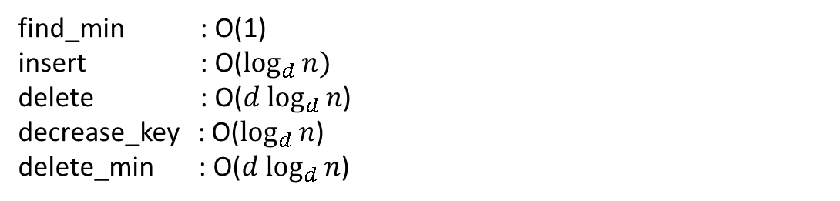
$d$-ary heap
It has child at most $d$
Extended version of binary heap
How it works ?
We use it for Prim algorithm
$$⋅⋅⋅$$
at most $d$
find_min : O(1)
insert : O($\log_{d}{n})$
delete : O($d \log_{d}{n}$)
decrease_key : O($\log_{d}{n}$)
delete_min : O($d \log_{d}{n}$)
Time complexity ?

Slide 8





Binomial tree
Definition
A binomial tree of height $k$ (denoted by $B_{k}$) is defined as follows
1. ${ B}_{0}$ consists of a single node.
2. $B_{k}$ is formed by joining two $B_{k−1}$ trees, making one’s root child of the other
$$B_{0}$$
$$B_{1}$$
$$B_{2}$$
$$B_{3}$$

Slide 9
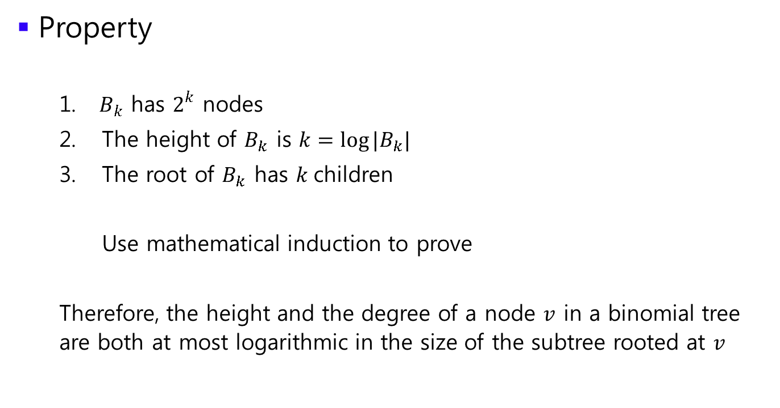
Binomial tree
Property
1. $B_{k}$ has $2^{k}$ nodes
The height of $B_{k}$ is $k=\log{|B_{k}|}$
The root of $B_{k}$ has $k$children
Use mathematical induction to prove
Therefore, the height and the degree of a node $v$ in a binomial tree are both at most logarithmic in the size of the subtree rooted at $v$

Slide 10

Binomial tree
Storing data
How can we store $n≠2^{k}$ nodes using binomial tree ?

Slide 11

Binomial tree
Storing data
How can we store $n≠2^{k}$ nodes using binomial tree ?
Think about binary notation of $n$

Slide 12

Binomial tree
Storing data
How can we store $n≠2^{k}$ nodes using binomial tree ?
Think about binary notation of $n$
We can use binomial tree chain ! We call it as root list
head
10
1
6
12
25
8
29
14
18
11
17
38
27

Slide 13


Binomial heap
Definition
A binomial heap is a (set of) binomial tree(s) where each node is associated with a key and the heap-order property is preserved. We also have the requirement that for any $i$ there is at most one $B_{i}.$
In other words, it doesn’t contain two $B_{i}$ in the binomial heap.
unique $B_{2}$
head
10
1
6
12
18
8
29
14
25
11
17
38
27

Slide 14
Binomial heap
Operations
find_min, delete_min, insert, delete, decrease_key

Slide 15

Binomial heap
Find_min
We need to consider all the root nodes of binomial tree
It takes O($\log{n}$). Why ?
head
10
1
6
12
18
8
29
14
25
11
17
38
27

Slide 16

Binomial heap
Find_min
We need to consider all the root nodes of binomial tree
It takes O($\log{n}$). Why ? we have $\log{n}$ binomial trees
head
10
1
6
12
18
8
29
14
25
11
17
38
27

Slide 17

Binomial heap
Decrease_key
Decrease the value and rearrange binomial tree
It takes O($\log{n}$)
head
10
1
6
12
18
8
29
14
25
11
17
38
27

Slide 18
Binomial heap
Decrease_key
Decrease the value and rearrange binomial tree
It takes O($\log{n}$)
head
10
1
6
12
18
8
29
14
25
11
2
38
27

Slide 19
Binomial heap
Decrease_key
Decrease the value and rearrange binomial tree
It takes O($\log{n}$)
head
10
1
6
12
18
2
29
14
25
11
8
38
27

Slide 20
Binomial heap
Decrease_key
Decrease the value and rearrange binomial tree
It takes O($\log{n}$)
head
10
1
2
12
18
6
29
14
25
11
8
38
27

Slide 21
Binomial heap
Delete_min
If we delete the root node of binomial tree, it is split into many trees
delete it !
head
10
1
2
12
18
6
29
14
25
11
8
38
27

Slide 22
Binomial heap
Delete_min
If we delete the root node of binomial tree, it is split into many trees
delete it ?
head
10
2
12
18
6
29
14
25
11
8
38
27

Slide 23
Binomial heap
Delete_min
If we delete the root node of binomial tree, it is split into many trees
Make another chain ! Then we get another binomial heap.
head
10
2
head’
12
18
6
29
14
25
11
8
38
27

Slide 24
Binomial heap
Delete_min
If we delete the root node of binomial tree, it is split into many trees
Make another chain ! Then we get another binomial heap.
Merge two binomial heaps into one ! How ?
head
10
2
head’
12
18
6
29
14
25
11
8
38
27

Slide 25
Binomial heap
Delete_min
If we delete the root node of binomial tree, it is split into many trees
Make another chain ! Then we get another binomial heap.
Merge two binomial heaps into one ! How ? Merging on merge sort ?
head
10
2
head’
12
18
6
29
14
25
11
8
38
27

Slide 26
Binomial heap
Delete_min
If we delete the root node of binomial tree, it is split into many trees
Make another chain ! Then we get another binomial heap.
Merge two binomial heaps into one !
head
10
12
18
2
25
6
29
14
11
8
38
27

Slide 27
Binomial heap
Delete_min
If we delete the root node of binomial tree, it is split into many trees
Make another chain ! Then we get another binomial heap.
Merge two binomial heaps into one !
Rearrange the binomial heap
head
10
12
18
2
25
6
29
14
11
8
38
27

Slide 28
Binomial heap
Delete_min
If we delete the root node of binomial tree, it is split into many trees
Make another chain ! Then we get another binomial heap.
Merge two binomial heaps into one !
Rearrange the binomial heap
head
10
12
18
2
25
6
29
14
11
8
38
27

Slide 29
Binomial heap
Delete_min
If we delete the root node of binomial tree, it is split into many trees
Make another chain ! Then we get another binomial heap.
Merge two binomial heaps into one !
Rearrange the binomial heap
head
10
18
2
12
25
6
29
14
11
8
38
27

Slide 30
Binomial heap
Delete_min
If we delete the root node of binomial tree, it is split into many trees
Make another chain ! Then we get another binomial heap.
Merge two binomial heaps into one !
Rearrange the binomial heap
head
10
18
2
12
25
6
29
14
11
8
38
27

Slide 31
Binomial heap
Delete_min
If we delete the root node of binomial tree, it is split into many trees
Make another chain ! Then we get another binomial heap.
Merge two binomial heaps into one !
Rearrange the binomial heap
head
10
2
12
18
6
29
14
25
11
8
38
27

Slide 32

Binomial heap
Delete_min
If we delete the root node of binomial tree, it is split into many trees
Make another chain ! Then we get another binomial heap.
Merge two binomial heaps into one !
Rearrange the binomial heap
head
10
2
12
18
6
29
14
25
11
8
38
27

Slide 33
Binomial heap
Delete_min
Time complexity ?
head
10
2
12
18
6
29
14
25
11
8
38
27

Slide 34

Binomial heap
Delete_min
Time complexity ?
Each node has at most $\log{n}$ child.
head
10
2
12
18
6
29
14
25
11
8
38
27

Slide 35

Binomial heap
Delete_min
Time complexity ?
Each node has at most $\log{n}$ child. New binomial heap consists of at most $\log{n}$ binomial trees
head
10
2
12
18
6
29
14
25
11
8
38
27

Slide 36

Binomial heap
Delete_min
Time complexity ?
Each node has at most $\log{n}$ child. New binomial heap consists of at most $\log{n}$ binomial trees Therefore, Merging and rearrange takes O($\log{n}$).
head
10
2
12
18
6
29
14
25
11
8
38
27

Slide 37

Binomial heap
Insert
Insert a new node and rearrange binomial heap
O($\log{n}$)
head
10
2
12
18
6
29
14
25
11
8
38
27

Slide 38

Binomial heap
Delete
Make it as -$∞$, and delete_min !
O($\log{n}$)
head
10
2
12
18
6
29
14
25
11
8
38
27

Slide 39
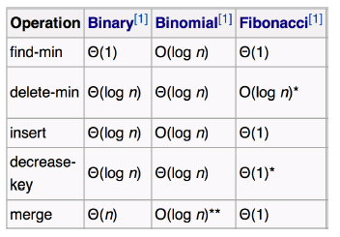
Fibonacci heap
Theoretically fastest heap
But it is just theoretical. It is slow if you implement it
We don’t use it
Similar with binomial heap
Relaxed version of binomial heap
Use a lazy update scheme.

Slide 40





Fibonacci heap
Main feature
Individual trees are not necessarily binomial (let me denote it as $B_{i}′$)
Allow many copies of $B_{i}′$ for the same $i$.
Operations
find_min, delete_min, insert, delete, decrease_key
head
10
1
3
6
12
18
11
27
8
14
20
11
17
38
$$B_{0}′$$
$$B_{2}′$$
$$B_{2}′$$
$$B_{3}′$$
I allow it because I’m lazy ☺

Slide 41
Fibonacci heap
Find_min
via pointer !
head
10
1
3
6
12
18
11
27
8
14
20
11
17
38
$$B_{0}′$$
$$B_{2}′$$
$$B_{2}′$$
$$B_{3}′$$

Slide 42

Fibonacci heap
Insert
Create a node. No update because I’m lazy ☺
Give $1 to inserted node. I’ll explain the meaning of ‘coin’ later.
head
7
10
1
3
6
12
18
11
27
8
14
20
11
17
38
$$B_{0}′$$
$$B_{0}′$$
$$B_{2}′$$
$$B_{2}′$$
$$B_{3}′$$

Slide 43

Fibonacci heap
Delete
-$∞$, delete_min
head
7
10
1
3
6
12
18
11
27
8
14
20
11
17
38
$$B_{0}′$$
$$B_{0}′$$
$$B_{2}′$$
$$B_{2}′$$
$$B_{3}′$$

Slide 44
Fibonacci heap
Delete_min
Delete min and rearrange Fibonacci heap.
Time complexity will proportional to the number of trees.
Is it fast ?
head
7
10
1
3
6
12
18
11
27
8
14
20
11
17
38
$$B_{0}′$$
$$B_{0}′$$
$$B_{2}′$$
$$B_{2}′$$
$$B_{3}′$$

Slide 45


Fibonacci heap
Delete_min
Delete min and rearrange Fibonacci heap.
Time complexity will proportional to the number of trees.
Is it fast ?
head
7
10
12
18
3
6
11
27
8
14
20
11
17
38
$$B_{0}′$$
$$B_{0}′$$
$$B_{0}′$$
$$B_{1}′$$
$$B_{2}′$$
$$B_{3}′$$

Slide 46




Fibonacci heap
Delete_min
Delete min and rearrange Fibonacci heap.
Time complexity will proportional to the number of trees.
Is it fast ?
head
7
10
18
3
6
12
11
27
8
14
20
11
17
38
$$B_{0}′$$
$$B_{1}′$$
$$B_{1}′$$
$$B_{2}′$$
$$B_{3}′$$

Slide 47



Fibonacci heap
Delete_min
Delete min and rearrange Fibonacci heap.
Time complexity will proportional to the number of trees.
Is it fast ?
head
7
10
3
6
12
18
11
27
8
14
20
11
17
38
$$B_{0}′$$
$$B_{2}′$$
$$B_{2}′$$
$$B_{3}′$$

Slide 48

Fibonacci heap
Delete_min
Delete min and rearrange Fibonacci heap.
Time complexity will proportional to the number of trees.
Is it fast ?
head
7
3
6
10
11
27
8
14
20
12
18
11
17
38
$$B_{0}′$$
$$B_{3}′$$
$$B_{3}′$$

Slide 49

Fibonacci heap
Delete_min
Delete min and rearrange Fibonacci heap.
Time complexity will proportional to the number of trees.
Is it fast ?
head
7
3
6
10
11
27
8
14
12
18
20
$$B_{0}′$$
11
17
$$B_{4}′$$
38

Slide 50
Fibonacci heap
Delete_min
Delete min and rearrange Fibonacci heap.
Time complexity will proportional to the number of trees.
Is it fast ? → we’ll analyze it soon.
head
7
3
6
10
11
27
8
14
12
18
20
$$B_{0}′$$
11
17
$$B_{4}′$$
38

Slide 51
Fibonacci heap
Decrease_key
Decrease the value of the element. If the heap-order property is violated, cut the link between the node and its parent. ( It may produce a result which is not a binomial tree)
Not just cut, we use “Cascading cut”
head
7
3
6
10
11
27
8
14
12
18
20
$$B_{0}′$$
11
17
$$B_{4}′$$
38

Slide 52
Fibonacci heap
Decrease_key
Decrease the value of the element. If the heap-order property is violated, cut the link between the node and its parent. ( It may produce a result which is not a binomial tree)
Not just cut, we use “Cascading cut”
head
7
3
6
10
11
27
decrease it to 4
8
14
12
18
20
$$B_{0}′$$
11
17
$$B_{4}′$$
38

Slide 53

Fibonacci heap
Decrease_key
Decrease the value of the element. If the heap-order property is violated, cut the link between the node and its parent. ( It may produce a result which is not a binomial tree)
Not just cut, we use “Cascading cut”
$$B_{0}′$$
head
7
3
6
4
11
27
decrease it to 4
→ heap-order is violated
8
14
12
18
20
11
17
$$B_{4}′$$
38

Slide 54

Fibonacci heap
Decrease_key
Decrease the value of the element. If the heap-order property is violated, cut the link between the node and its parent. ( It may produce a result which is not a binomial tree)
Not just cut, we use “Cascading cut”
$$B_{0}′$$
$$B_{0}′$$
head
7
4
3
6
11
27
decrease it to 4
heap-order is violated
Cut !
8
14
12
18
20
11
17
$$B_{4}′$$
38

Slide 55



Fibonacci heap
Decrease_key
Decrease the value of the element. If the heap-order property is violated, cut the link between the node and its parent. ( It may produce a result which is not a binomial tree)
Not just cut, we use “Cascading cut”
$$B_{0}′$$
$$B_{0}′$$
$$B_{0}′$$
$$B_{1}′$$
head
7
4
12
18
3
6
11
27
decrease it to 4
heap-order is violated
Cut !
8
14
20
11
17
$$B_{4}′$$
38

Slide 56
Cascading cut
Definition
1. Whenever a node is being cut, mark the parent of the cut node in the original tree, and
Pay $1 for the cut
Store $2 in the parent of the cut node
Store $1 in the new root (cut node).
$$B_{0}′$$
$$B_{0}′$$
$$B_{0}′$$
$$B_{1}′$$
head
7
4
12
18
3
marked!
6
11
27
decrease it to 4
heap-order is violated
Cut !
8
14
20
11
17
$$B_{4}′$$
38

Slide 57

Cascading cut
Definition
2. When a 2nd child of a node $v$ is lost (cutting a child of an already marked node), by that time node $v$ will have accumulated $ 4; recursively cut that node from its parent, marking again the parent of $v$ and using $4 to pay for the operation before. $1 for the cut, $2 to its parent, $1 to the new root
$$B_{0}′$$
$$B_{0}′$$
$$B_{0}′$$
$$B_{1}′$$
head
7
4
12
18
3
6
11
27
8
14
20
decrease it to 2 !
11
17
$$B_{4}′$$
38

Slide 58
Cascading cut
Definition
2. When a 2nd child of a node $v$ is lost (cutting a child of an already marked node), by that time node $v$ will have accumulated $ 4; recursively cut that node from its parent, marking again the parent of $v$ and using $4 to pay for the operation before. $1 for the cut, $2 to its parent, $1 to the new root
$$B_{0}′$$
$$B_{0}′$$
$$B_{0}′$$
$$B_{1}′$$
head
7
4
12
18
3
6
2
27
8
14
20
decrease it to 2 !
11
17
$$B_{4}′$$
38

Slide 59



Cascading cut
Definition
2. When a 2nd child of a node $v$ is lost (cutting a child of an already marked node), by that time node $v$ will have accumulated $ 4; recursively cut that node from its parent, marking again the parent of $v$ and using $4 to pay for the operation before. $1 for the cut, $2 to its parent, $1 to the new root
$$B_{0}′$$
$$B_{0}′$$
$$B_{0}′$$
$$B_{1}′$$
$$B_{1}′$$
marked twice. It has $4
$$B_{4}′$$
head
7
4
12
18
2
3
6
27
8
14
20
decrease it to 2 !
11
17
38

Slide 60





Cascading cut
Definition
2. When a 2nd child of a node $v$ is lost (cutting a child of an already marked node), by that time node $v$ will have accumulated $ 4; recursively cut that node from its parent, marking again the parent of $v$ and using $4 to pay for the operation before. $1 for the cut, $2 to its parent, $1 to the new root
$$B_{0}′$$
$$B_{0}′$$
$$B_{0}′$$
$$B_{0}′$$
$$B_{0}′$$
$$B_{1}′$$
$$B_{1}′$$
$$B_{3}′$$
head
7
4
12
3
27
18
2
6
8
14
20
11
17
38

Slide 61
Cascading cut
Time complexity of cascading cut
Each node has the coin they already have. Each cut requires only $4, and decrease_key takes overall still amortized time O(1) ( Overall cost / The number of operation )
$$B_{0}′$$
$$B_{0}′$$
$$B_{0}′$$
$$B_{0}′$$
$$B_{0}′$$
$$B_{1}′$$
$$B_{1}′$$
$$B_{3}′$$
head
7
4
12
3
27
18
2
6
8
14
20
11
17
38

Slide 62
Fibonacci heap
Decrease_key
Decrease the value of the element. If the heap-order property is violated, cut the link between the node and its parent. ( It may produce a result which is not a binomial tree)
Not just cut, we use “Cascading cut”
$$B_{0}′$$
$$B_{0}′$$
$$B_{0}′$$
$$B_{0}′$$
$$B_{0}′$$
$$B_{1}′$$
$$B_{1}′$$
$$B_{3}′$$
head
7
4
12
3
27
18
2
6
8
14
20
11
17
38

Slide 63
Fibonacci heap
Analysis
Cascading cut takes O(1)
$$B_{0}′$$
$$B_{0}′$$
$$B_{0}′$$
$$B_{0}′$$
$$B_{0}′$$
$$B_{1}′$$
$$B_{1}′$$
$$B_{3}′$$
head
7
4
12
3
27
18
2
6
8
14
20
11
17
38

Slide 64
Fibonacci heap
Analysis
Cascading cut takes O(1)
How much is merging cost ? O(1) because of the coin
$$B_{0}′$$
$$B_{0}′$$
$$B_{0}′$$
$$B_{0}′$$
$$B_{0}′$$
$$B_{1}′$$
$$B_{1}′$$
$$B_{3}′$$
head
7
4
12
3
27
18
2
6
8
14
20
11
17
38

Slide 65
Fibonacci heap
Analysis
Cascading cut takes O(1)
After cut, we get (# of child) additional trees
How much is merging cost per child ? O(1) because of the coin
How many child does a node has ?
$$B_{0}′$$
$$B_{0}′$$
$$B_{0}′$$
$$B_{0}′$$
$$B_{0}′$$
$$B_{1}′$$
$$B_{1}′$$
$$B_{3}′$$
head
7
4
12
3
27
18
2
6
8
14
20
11
17
38

Slide 66
Fibonacci heap
Analysis
Cascading cut takes O(1)
After cut, we get (# of child) additional trees
How much is merging cost per child ? O(1) because of the coin
How many child does a node has ? → Degree of a node
$$B_{0}′$$
$$B_{0}′$$
$$B_{0}′$$
$$B_{0}′$$
$$B_{0}′$$
$$B_{1}′$$
$$B_{1}′$$
$$B_{3}′$$
head
7
4
12
3
27
18
2
6
8
14
20
11
17
38

Slide 67
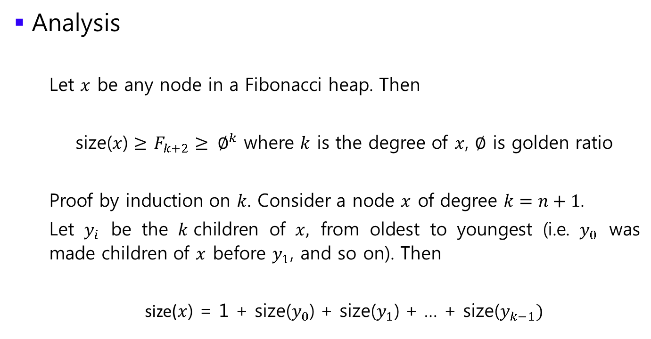
Fibonacci heap
Analysis
Let $x$ be any node in a Fibonacci heap. Then
size($x$) $≥$ $F_{k+2}≥ ∅^{k}$ where $k$ is the degree of $x$, $∅$ is golden ratio
Proof by induction on $k$. Consider a node $x$ of degree $k=n+1$.
Let $y_{i}$ be the $k$children of $x,$ from oldest to youngest (i.e. $y_{0}$ was made children of $x$ before $y_{1}$, and so on). Then
size($x$) = 1 + size($y_{0}$) + size($y_{1}$) + … + size($y_{k−1})$

Slide 68
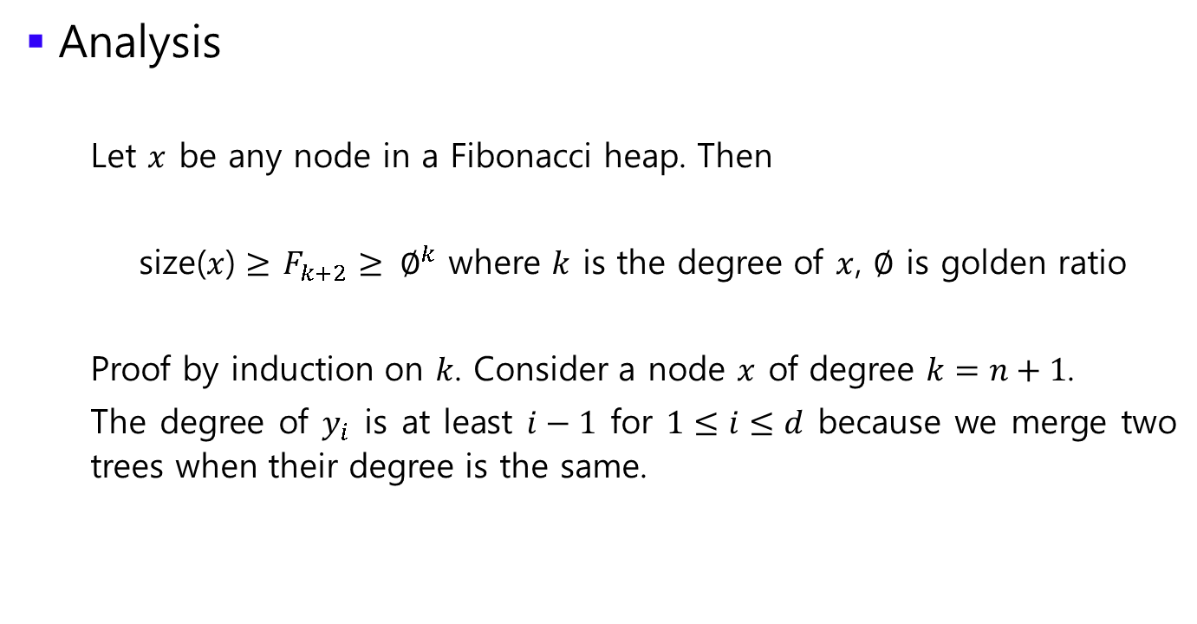
Fibonacci heap
Analysis
Let $x$ be any node in a Fibonacci heap. Then
size($x$) $≥$ $F_{k+2}≥ ∅^{k}$ where $k$ is the degree of $x$, $∅$ is golden ratio
Proof by induction on $k$. Consider a node $x$ of degree $k=n+1$.
The degree of $y_{i}$ is at least $i−1$ for $1≤i≤d$ because we merge two trees when their degree is the same.

Slide 69
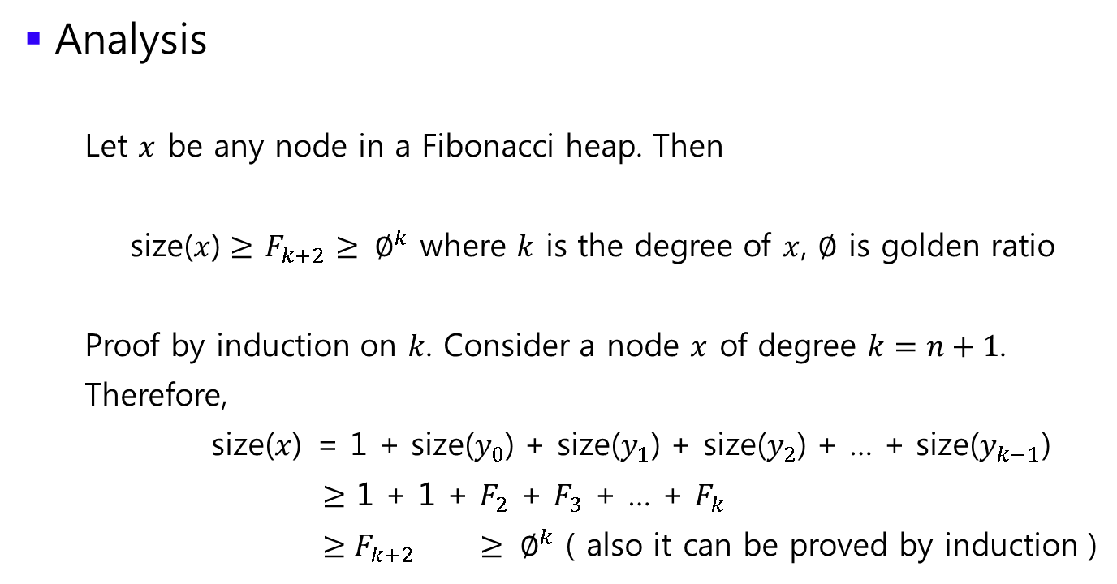
Fibonacci heap
Analysis
Let $x$ be any node in a Fibonacci heap. Then
size($x$) $≥$ $F_{k+2}≥ ∅^{k}$ where $k$ is the degree of $x$, $∅$ is golden ratio
Proof by induction on $k$. Consider a node $x$ of degree $k=n+1$.
Therefore,
size($x$) = 1 + size($y_{0}$) + size($y_{1}$) + size($y_{2}$) + … + size($y_{k−1}$)
$≥$ 1 + 1 + $F_{2}$ + $F_{3}$ + … + $F_{k}$
$≥F_{k+2} ≥ ∅^{k}$ ( also it can be proved by induction )

Slide 70

Fibonacci heap
Analysis
Therefore, $k≤\log_{∅}{size (x)}$.
$$∴k≤\log{n}$$
Therefore, decrease_key takes O($\log{n}$)

